Slide 1
SHA3-FPGA: Secure Hash Algorithm 3 Implementation on an FPGA with the MicroBlaze Microprocessor
Group A
Yuta Akiya, Kyle Thomas Le, Megan Luong, Dr. Mohamed El-Hadedy
California State Polytechnic University, Pomona
Department of Electrical and Computer Engineering
{yakiya, kylethomasle, mmluong, mealy}@cpp.edu

Slide 2
Motivation
SHA-1 and SHA-2 are vulnerable to attacks.
Need more hardware with SHA-3 support.
Analyze performance of SHA-3 implementation on FPGA.
The performance is important for hashing algorithms because it means more time executing other important operations.

Slide 3
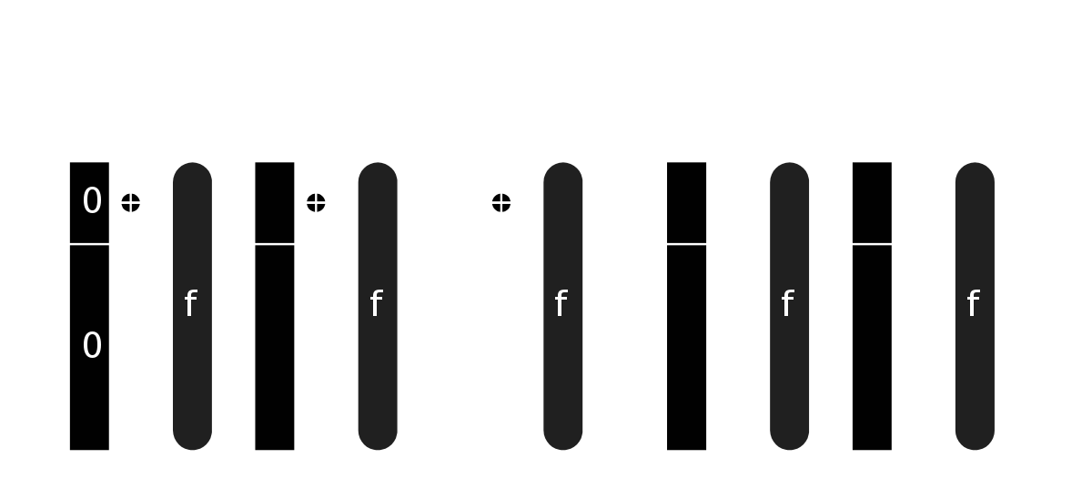
SHA-3
Secure Hash Algorithm 3
Different internal structure than SHA-1 / SHA-2
Sponge Construction

Slide 4
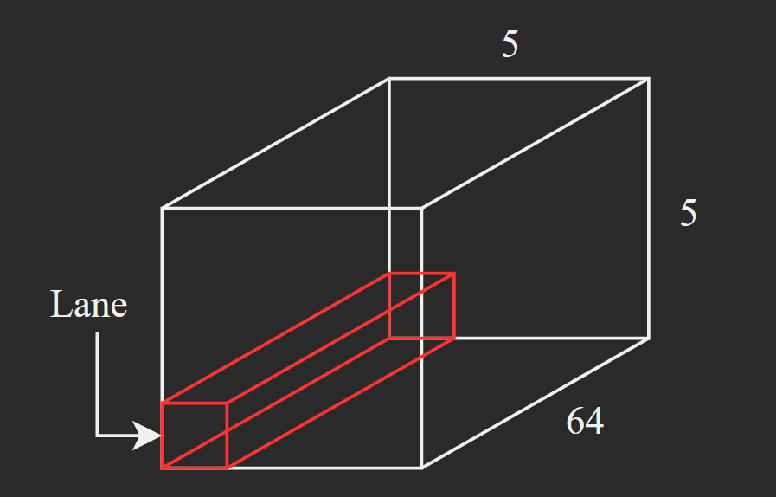
SHA-3 Algorithm
Absorbing
Format input message into 1600-bit message to permutate.
24 Rounds of 5 stages of Keccak permutations
Theta, Rho, Pi, Chi, Iota

Slide 5
Theta
C[x] = A[x,0] xor A[x,1] xor A[x,2] xor A[x,3] xor A[x,4], for x in 0…4
D[x] = C[x-1] xor rot(C[x+1],1), for x in 0…4
A[x,y] = A[x,y] xor D[x], for (x,y) in (0…4,0…4)
Rho and Pi
B[y,2*x+3*y] = rot(A[x,y], r[x,y]), for (x,y) in (0…4,0…4)
Chi
A[x,y] = B[x,y] xor ((not B[x+1,y]) and B[x+2,y]), for (x,y) in (0…4,0…4)
Iota
A[0,0] = A[0,0] xor RC

Slide 6
SHA-3 Algorithm cont.
Squeezing
Truncate 1600 bit output of Keccak permutations to certain length
Output length can vary with the version of SHA-3
224, 256, 384, 512 bits.

Slide 7
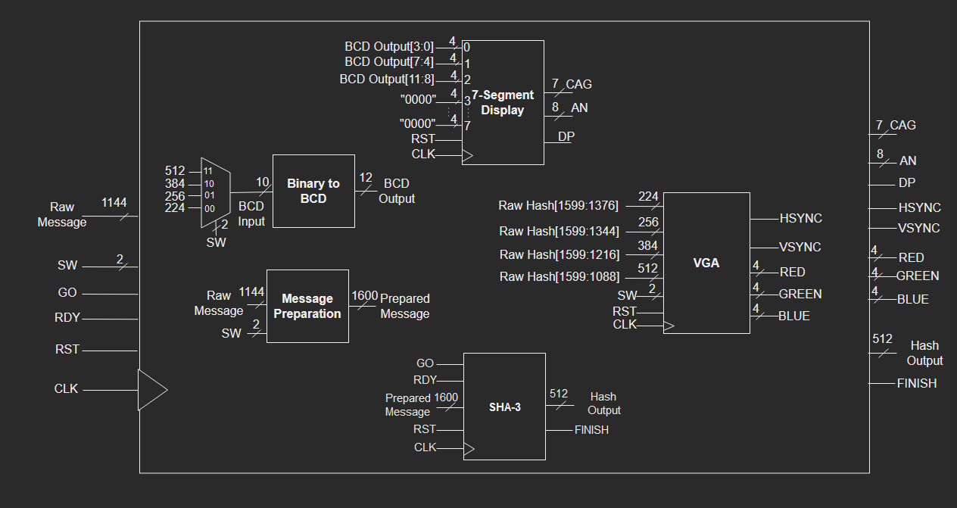
Top Module Design

Slide 8
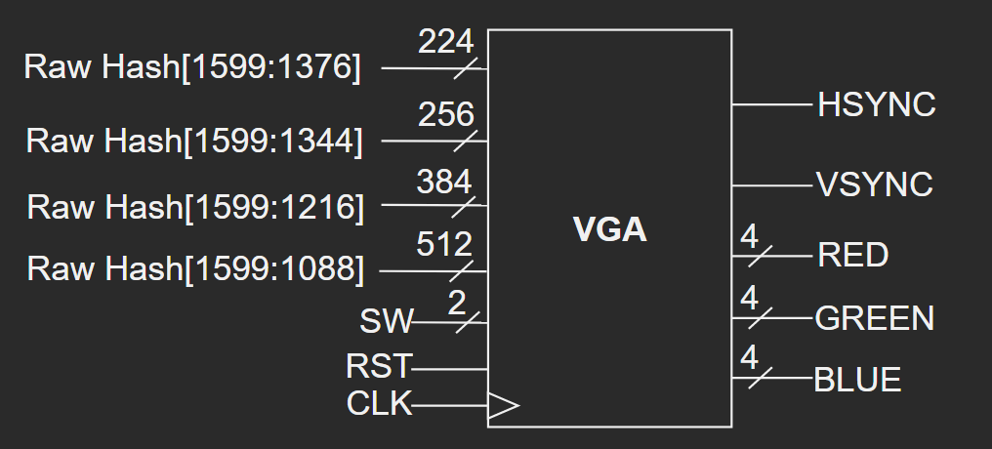
VGA Module

Slide 9
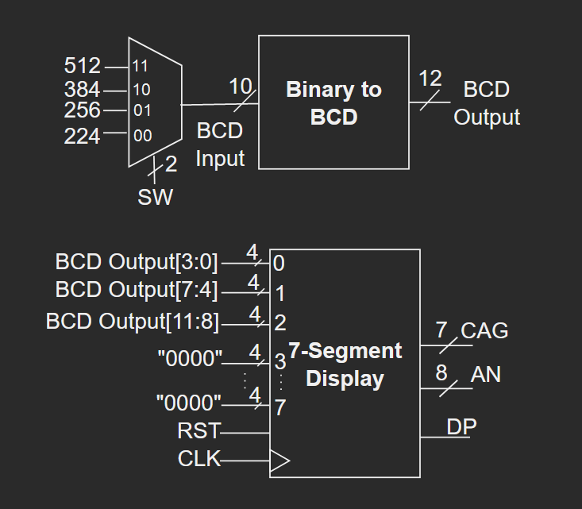
7-Segment Display Module

Slide 10
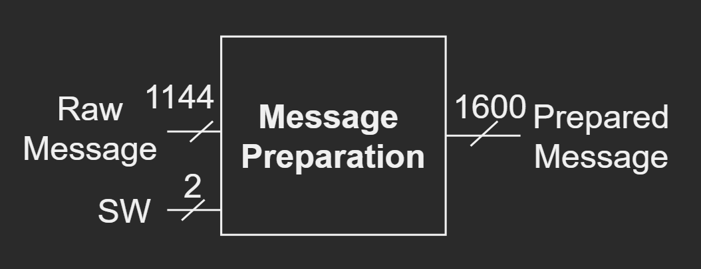
Message Preparation Module

Slide 11
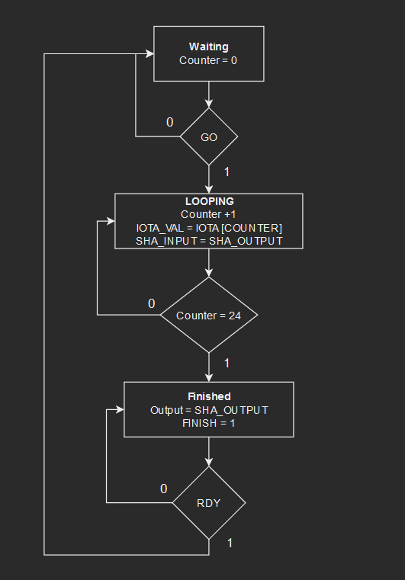
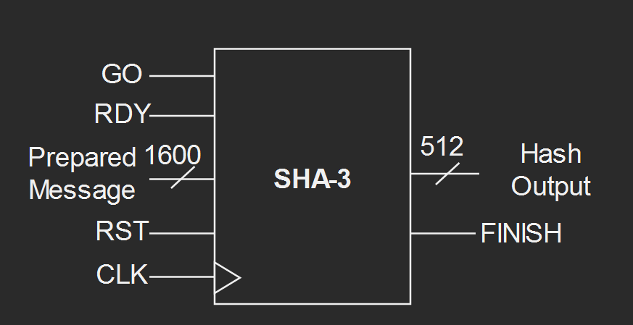
SHA-3 Module

Slide 12
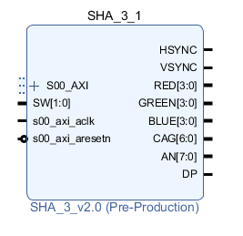
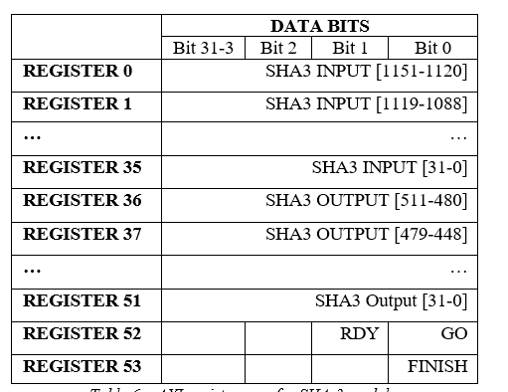
MicroBlaze Integration with UART
System integrated with MicroBlaze microprocessor.
Provides AXI connectivity
C/C++ overhead
Better UART compatibility
Low-powered
Low resource utilization
Allow finer control and more flexibility of system.
Package VHDL code into an Intellectual Property (IP) with AXI.

Slide 13
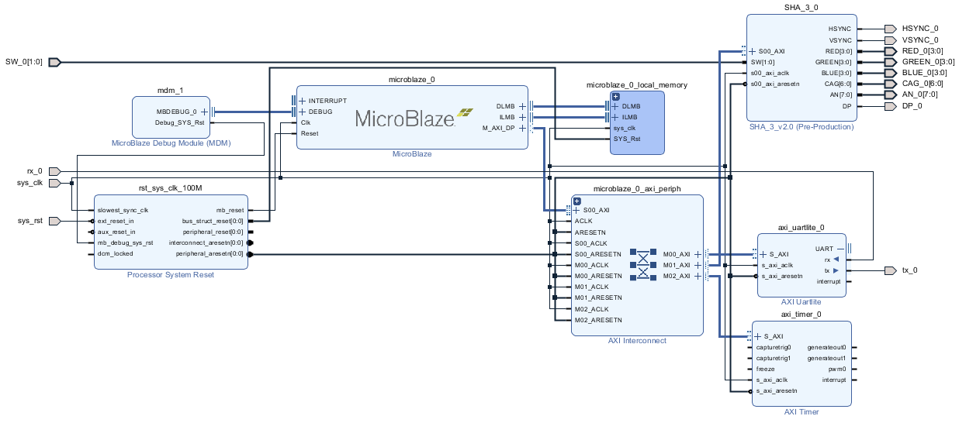
MicroBlaze Block Diagram

Slide 14
Difficulties
Implementing complex Keccak permutations
Difficult to implement all stages flawlessly without verifying stages individually
Solution: Output of each permutation stage was compared with outputs of Keccak implementations in other programming languages (C / JavaScript).
Integrating MicroBlaze and AXI to transfer values from C/C++ overhead to the custom SHA-3 IP.
Solution: Create a register map to help organize how data is transferred.

Slide 15
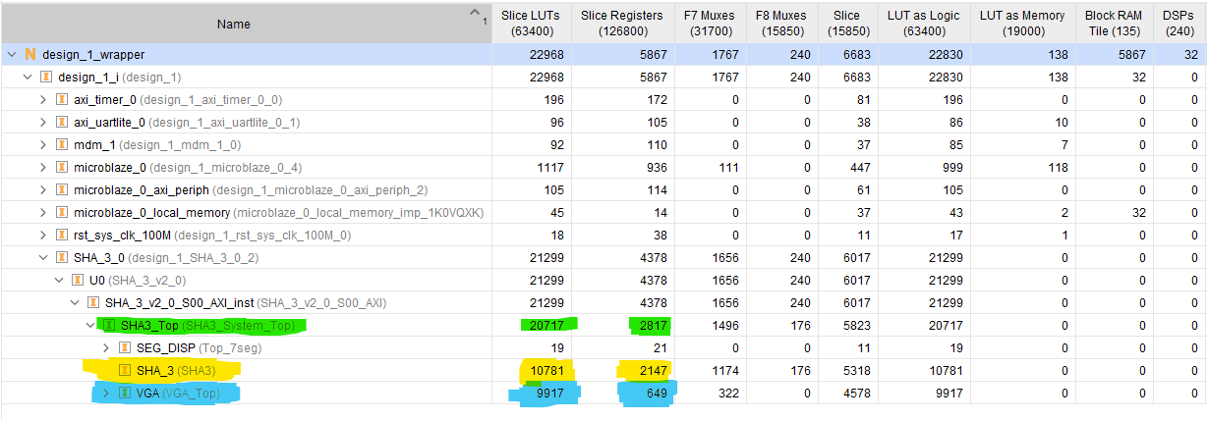
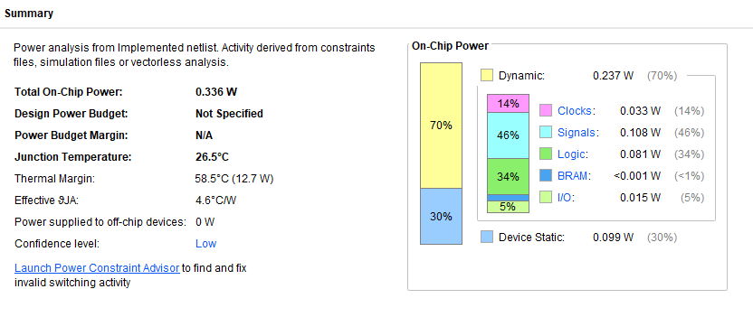
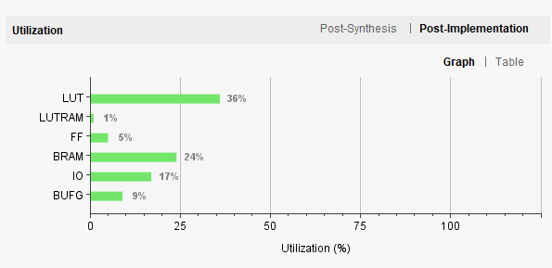
Results - Utilization / Power

Slide 16
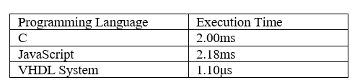
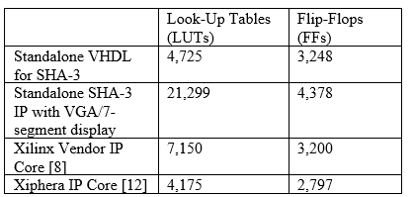
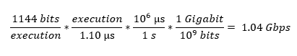
Results - Comparisons

Slide 17
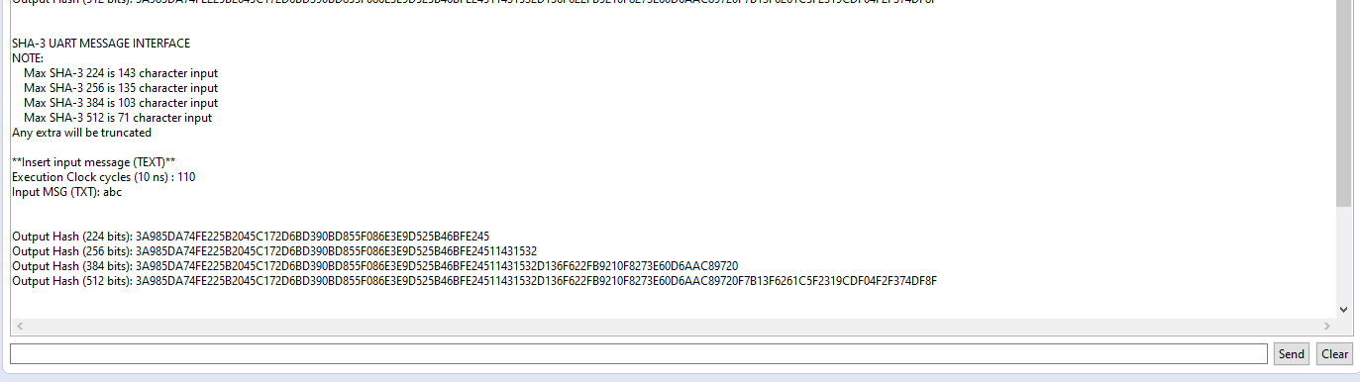
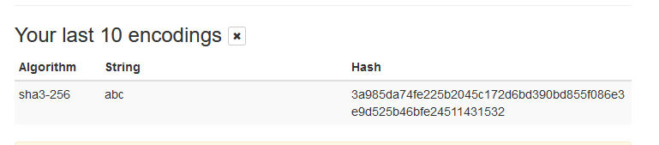
Results - Output UART
https://md5calc.com/hash/sha3-256/abc

Slide 18
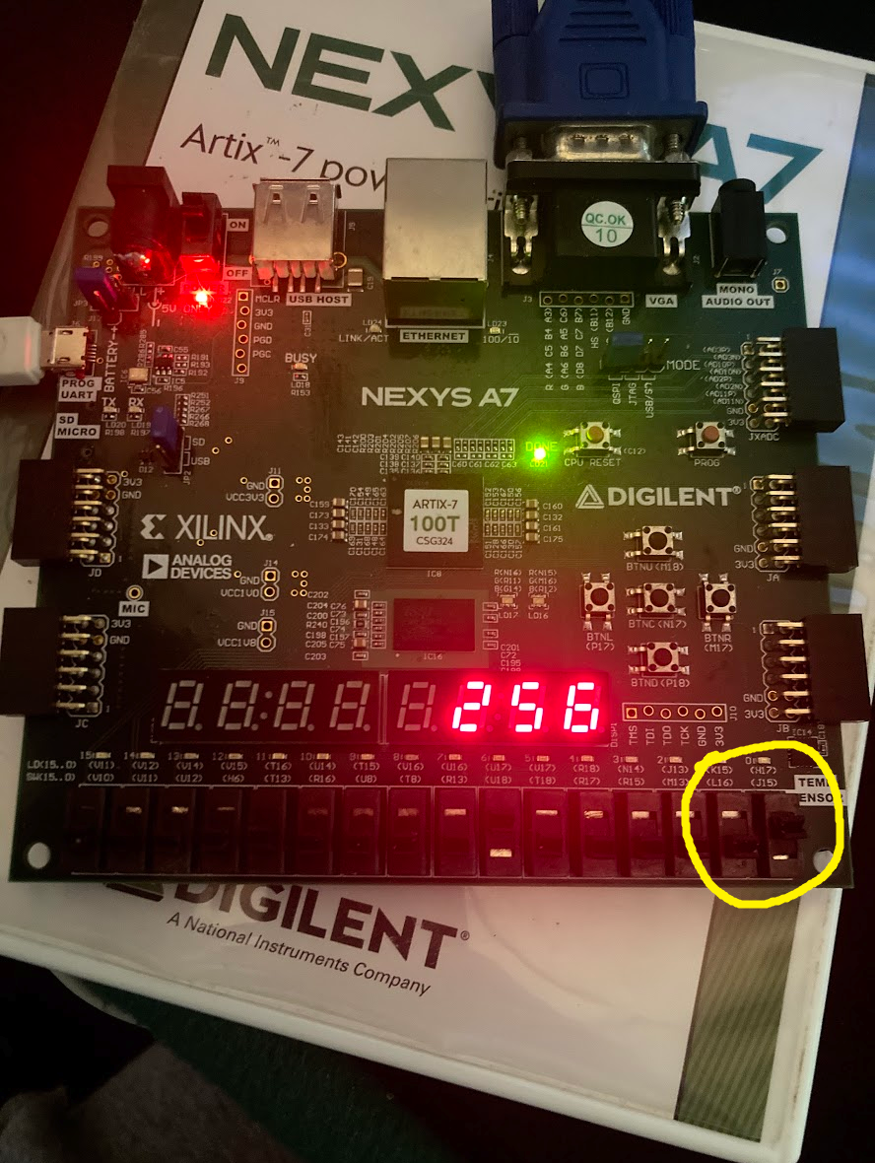
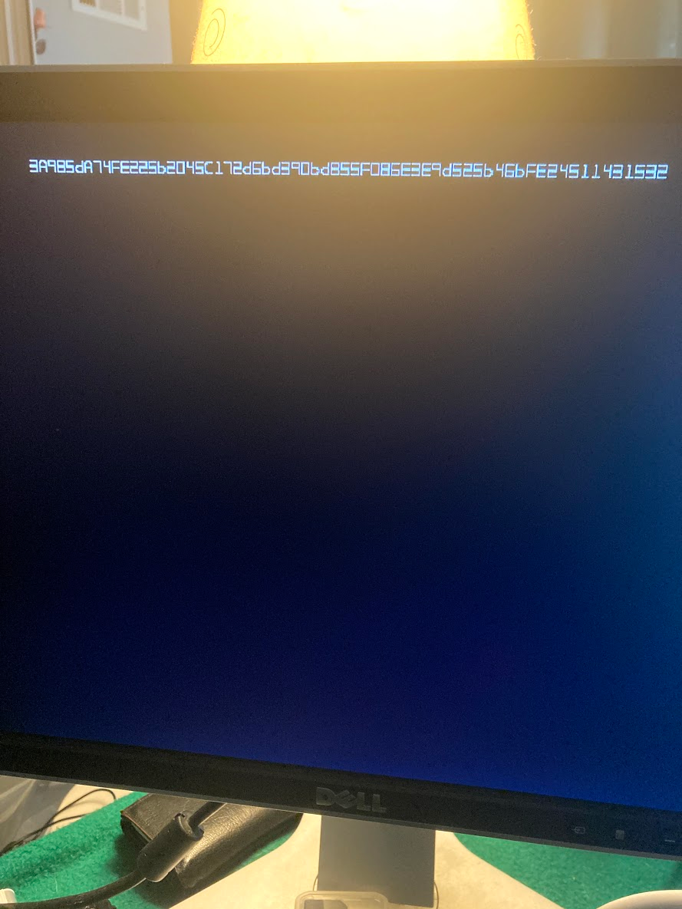
Results - Output VGA / 7-Segment Display / Switches

Slide 19
Conclusion
Performance of SHA-3 implementation on FPGA is concluded to be competitive with the performance of software implementations.
Servers and systems that aim to potentially increase the performance of hashing using SHA-3 could look towards FPGA acceleration cores.

Slide 20
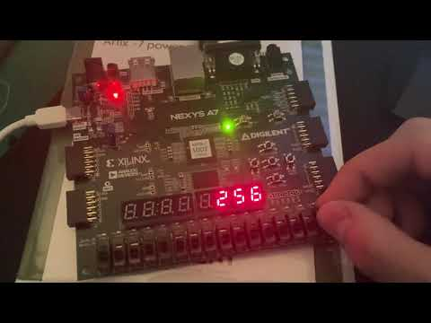
SHA-3 Demo on Nexys A7 Board
https://youtu.be/dnKnt28N3SQ

Slide 21
References
https://keccak.team/keccak_specs_summary.html

Slide 22
Thank You
Group A
Yuta Akiya, Kyle Le, Megan Luong, Dr. Mohamed El-Hadedy
California Polytechnic State University, Pomona
Department of Electrical and Computer Engineering
{yakiya, kylethomasle, mealy}@cpp.edu

